Slide 1
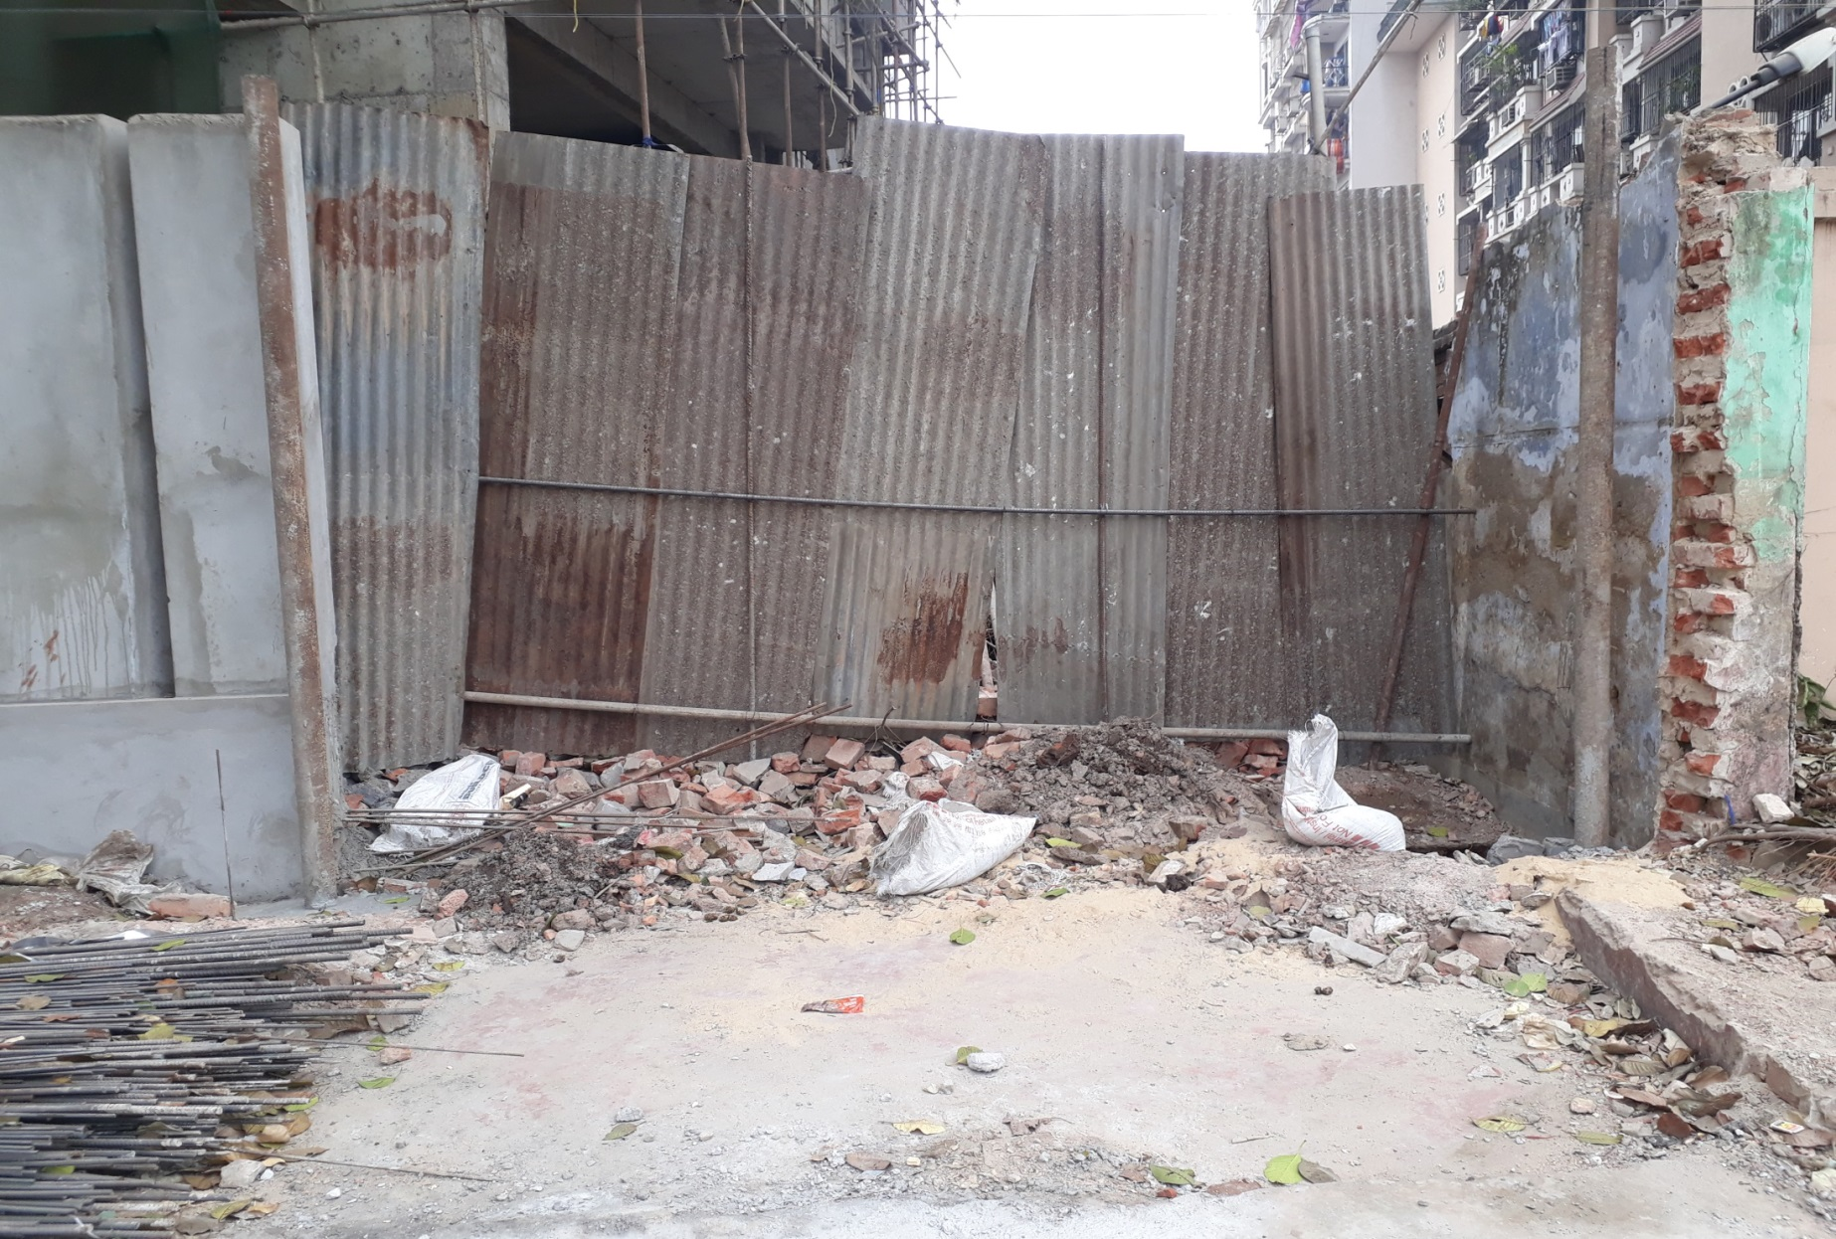
GATE NO 2 WIP

Slide 2
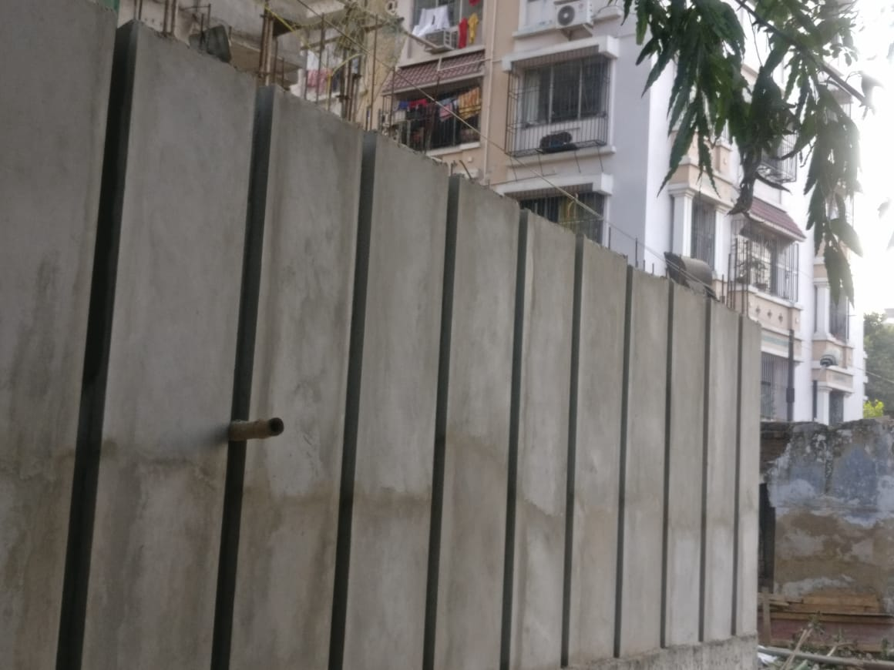
FRONT SIDE BOUNDARY WALL WIP

Slide 3
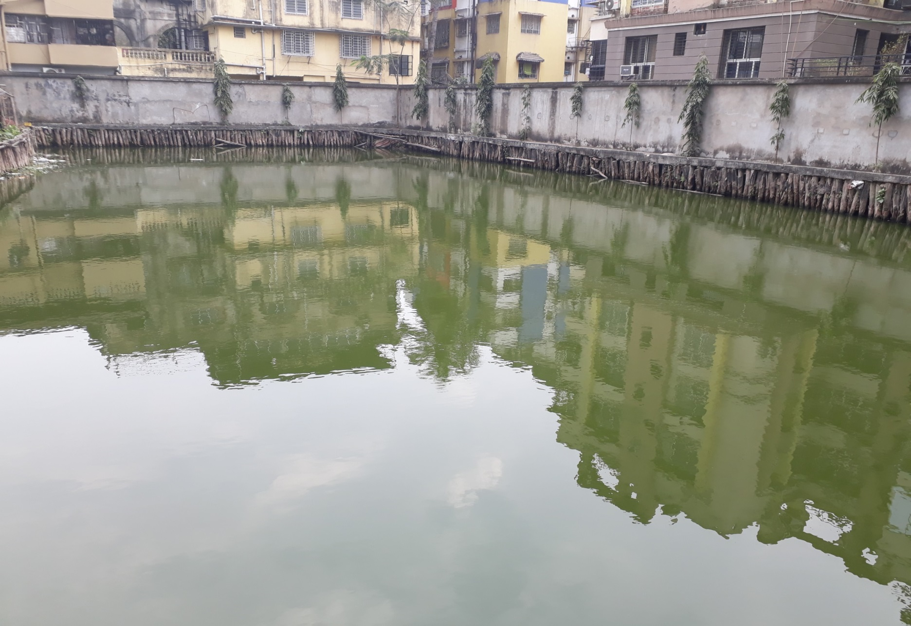
WATER BODY

